Slide 1

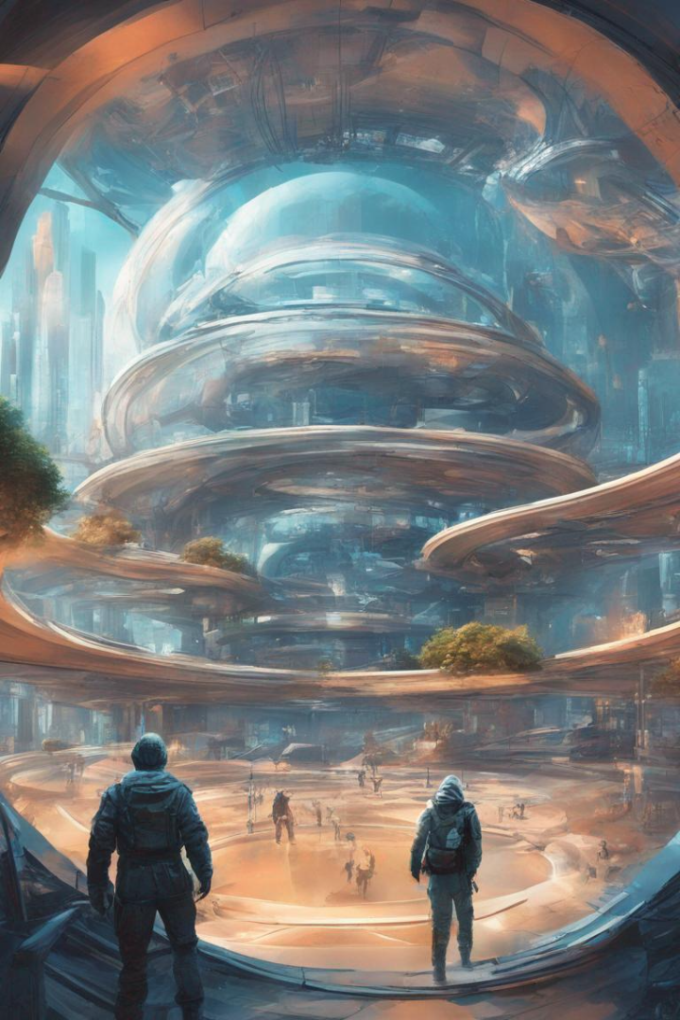

Non-fungible Tokens applications in Real World and Metaverse
L
by Lavanya Moolya

Slide 2
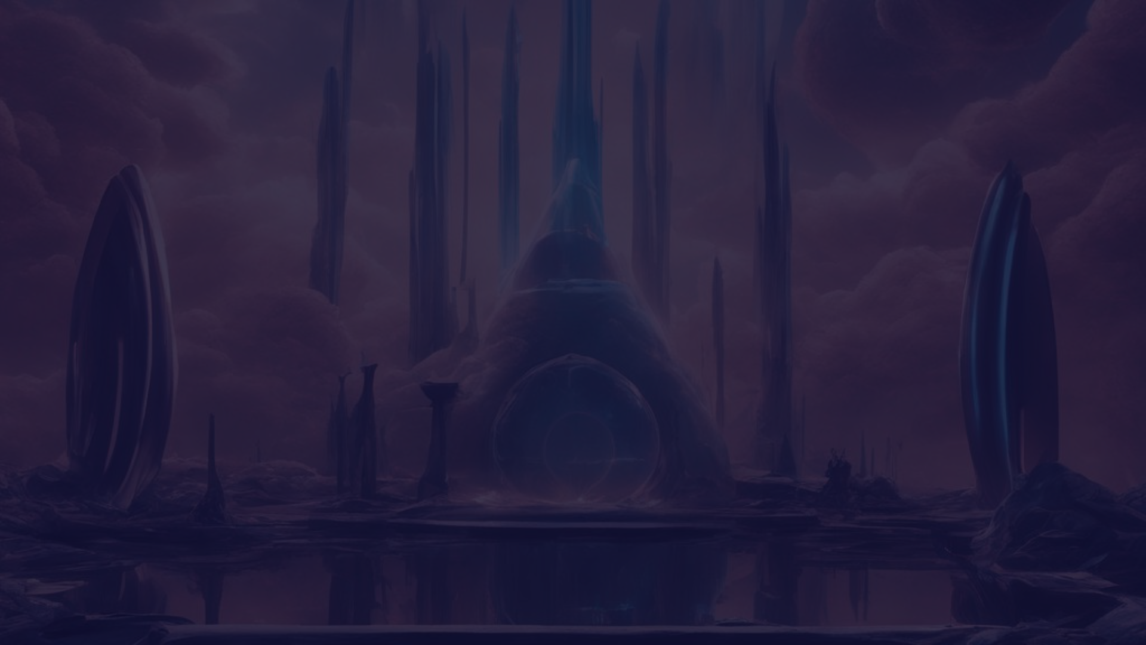
Table of Contents
Abstract
Introduction
Literature Review
Problem Statement and Objective
Algorithm Used
Working
Future Work
Conclusion
References

Slide 3
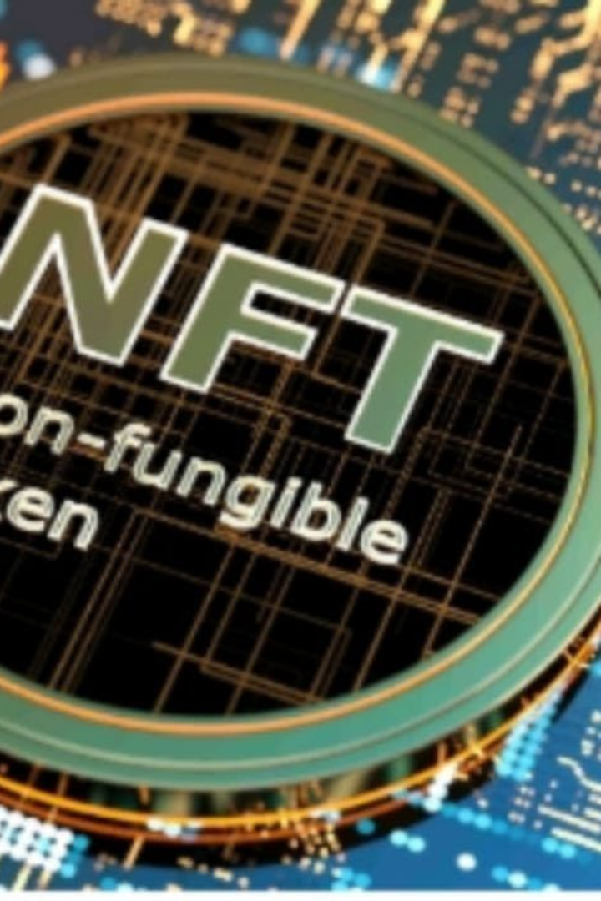
Abstract
A comprehensive review of the applications of Non-Fungible Tokens (NFTs) in the real world and the Metaverse. It explores the growth and popularity of NFTs, their various applications in industries, and their potential use in the virtual world. The study highlights the role of NFTs in identity management and ownership rights of digital assets. It also discusses future directions for NFT applications in industry and academic research.
Keywords: Blockchain; Identity management; NFT applications; Ownership proof; Virtual world

Slide 4
Introduction
Non-fungible tokens (NFTs) are unique digital assets that are stored on a blockchain.
They have gained popularity in both the real world and the metaverse.
In the real world, NFTs are used for various applications such as art, collectibles, and virtual real estate.
In the metaverse, NFTs enable users to own and trade virtual assets like avatars, virtual land, and virtual goods.
These applications have created new opportunities for creators, artists, and investors.

Slide 5
Literature Review
Title
Year
Publication
Authors
Methodology
A Review of Non-fungible Tokens Applications in the Real-world and Metaverse
2022
Science Direct
Saeed Banaeian Far a, Seyed Mojtaba Hosseini Bamakan b c,
Use of NFTs to represent ownership of digital assets, to create new forms of gaming experiences, and facilitate financial transactions. Impact of NFTs on the metaverse, a virtual world
Digital future of luxury brands: Metaverse, digital fashion, and non-fungible tokens
2022
Journal of Strategic Marketing
Choi and Kim
Theoretical framework development to explore digital fashion's impact on consumer behavior

Slide 6
Literature Review
Title
Year
Publication
Authors
Methodology
Non-Fungible Token: A Systematic Review and Research Agenda
2022
MDPI
Hong Bao , and David Roubaud
Asset pricing and a disconnect from real-world applications, calling for further research in areas like tokenomics and risk analysis
Metaverse and non-fungible tokens (NFTs): what they mean for IP
2022
Journal of Strategic Marketing
Brian King
IP protection in the metaverse and NFTs. outlining challenges like the dynamic nature of virtual assets and the limitations of trademark protection

Slide 7
Problem Statement and Objective
Problem
Objective
Explore new applications of Non-Fungible Tokens (NFTs) in the Metaverse, aiming to make NFTs more applicable in the virtual world
The advantages and implications of using NFTs in the Metaverse, specifically in terms of their applications in digital asset ownership, identity management, and proof of ownership
How NFTs can effectively enable ownership, scarcity, and verifiability in the Metaverse, unlocking new possibilities for creators and users
To highlight how NFTs can enhance the virtual experiences of users and provide new opportunities for creators in the Metaverse.
Understanding the potential of NFTs in the Metaverse, the study aims to contribute to the development of innovative solutions and future directions for NFT applications in both industry and academic research

Slide 8
Algorithms Used
Token Standard Algorithms:
Ownership Verification Algorithms:
ERC-721 and ERC-1155 Standard Algorithms
Public Key Cryptography
Minting Algorithm
Digital Signature Verification Algorithm
Transfer Algorithm
Decentralized Identifiers (DIDs):
Metadata Handling:
DID Generation Algorithm
JSON Parsing Algorithm
DID Verification Algorithm
IPFS Content Addressing Algorithm

Slide 9
Algorithms Used
Smart Contracts:
Interoperability:
Solidity Smart Contract Algorithms
Cross-Chain Bridge Protocol Algorithms
Minting Algorithm
Royalty Distribution Algorithm
Provenance, Authentication, and Timestamping:
Blockchain Timestamping
Hash Chain Creation
Data Provenance Algorithm
Digital Certificate Generation

Slide 10
Algorithms Used
Virtual Economies and Pricing Models:
Gamification and Engagement:
Game Logic Algorithms
Supply and Demand Modeling Algorithms
In-Game Reward Distribution
Dynamic Pricing Algorithms
User Interaction Algorithms
Auction Algorithms
Gamified Engagement Metrics
Automated Pricing Strategies
Metaverse World-building:
Procedural Generation Algorithms
Virtual Landscape Generation
Asset Creation Algorithms
Dynamic World Design Algorithms

Slide 11

Working
Working of NFTs in the Real World:
Digital Asset Creation: Create a unique digital item.
Tokenization: Convert the digital item into an NFT on a blockchain.
Ownership and Transfer: Use blockchain to prove ownership and trade NFTs.
Marketplaces: List NFTs for sale in online marketplaces.

Slide 12
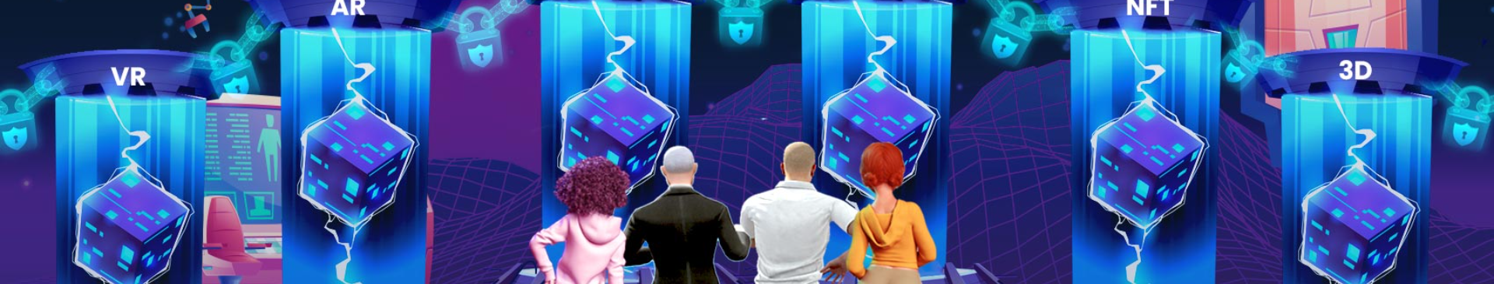
Working
Working of NFTs in the Metaverse:
Virtual Asset Creation: Create digital assets for the virtual world.
Tokenization: Tokenize virtual assets as NFTs on metaverse-specific platforms.
Integration: Integrate NFTs into the metaverse ecosystem.
Virtual Economy: Use NFTs for virtual land, avatars, and in-game items.
Metaverse Marketplaces: Buy, sell, and display NFTs within the metaverse platforms.

Slide 13
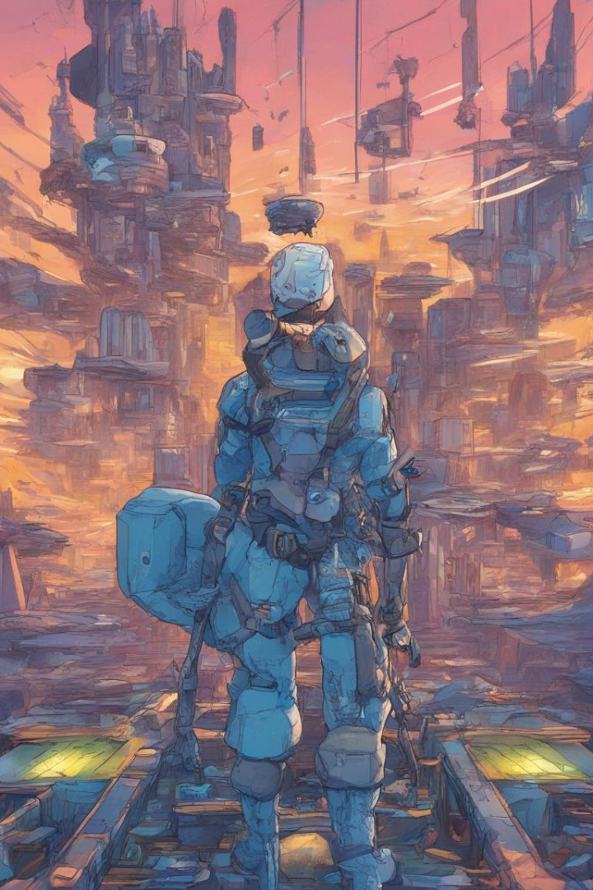
Applications
1
Art Applications
2
Gaming Applications
The use of NFTs has transformed the art world, providing a new revenue stream for digital artists.
NFTs can be used to represent in-game assets that can be purchased and traded.
3
Real Estate Applications
NFTs are being used to represent ownership of properties, providing a more transparent and secure way of recording real estate transactions.

Slide 14

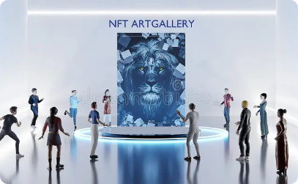

Future Work
Technological Advancements
Regulatory Frameworks
Community Engagement
As blockchain technology continues to evolve, new NFT applications may emerge, such as for supply chain management
Regulatory frameworks for NFTs are likely to emerge as the market grows, but this presents challenges such as balancing innovation and regulation.
More efforts need to be made to engage diverse communities and promote an inclusive NFT market.

Slide 15
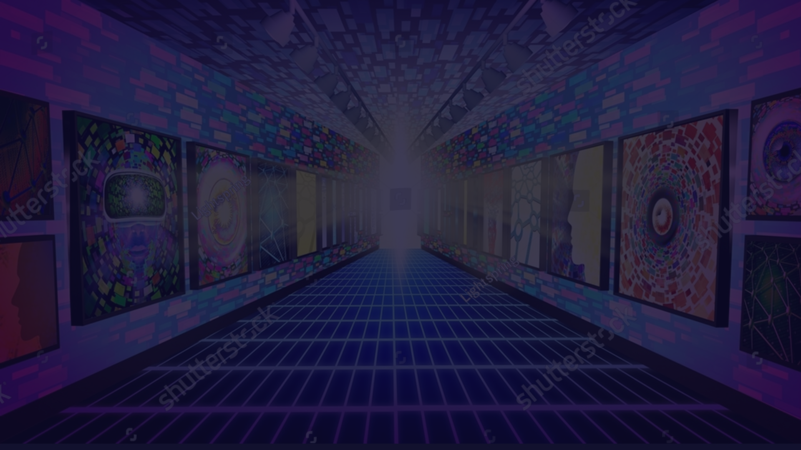
Conclusion
1
Summary of Key Points
2
Future Prospects of NFTs
NFTs are unique digital assets that have gained significant attention and value in recent years. They have transformed the art world, gaming, and real estate. Despite their potential, NFTs face challenges related to legality, copyright, environmental impact, and accessibility.
NFTs have the potential to change the way we think about ownership and value, but to fully realize this potential, innovative solutions are necessary to promote a sustainable and inclusive NFT market.

Slide 16

References
[1] Saeed Banaeian Far a, Seyed Mojtaba Hosseini Bamakan b c, Qiang Qu c, Qingshan Jiang c, "A Review of Non-fungible Tokens Applications in the Real-world and Metaverse". ScienceDirect (2022)
[2] Annamma Joy, Ying Zhu, Camilo Peña, Myriam Brouard, "Digital future of luxury brands: Metaverse, digital fashion, and non-fungible tokens". Wiley Online Library (2022)
[3] Brian King, "Metaverse and non-fungible tokens (NFTs): what they mean for IP". Clarivate (2022)
[4] Hong Bao, David Roubaud, "Non-Fungible Token: A Systematic Review and Research Agenda". MDPI (2022).
[5] Najam A. Anjum, Mubashir Husain Rehmani, "Non-Fungible Tokens in Business and Management -- A Review". arXiv (2022)
[6] Alfredo J. Perez, Badis Hammi Sherali Zeadally, "Non-Fungible Tokens: A Review". IEEE(2022)

